Slide 1
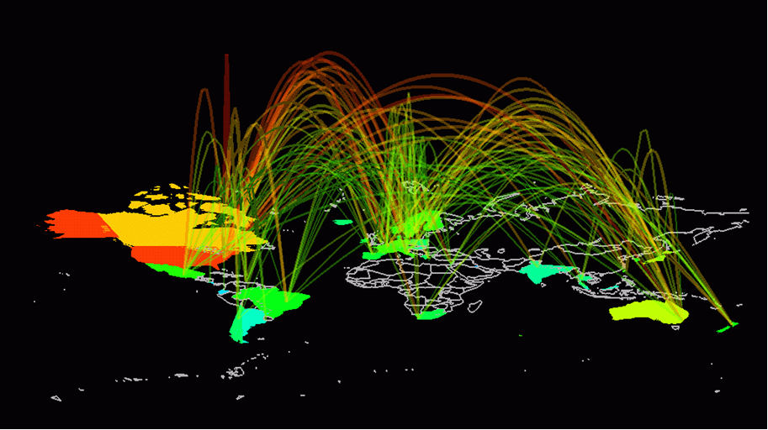
Software ideals and history (slightly updated from PPP2)
Bjarne Stroustrup
www.stroustrup.com/programming

Slide 2
Abstract
This is a very brief and very selective history of software as it relates to programming, and especially as it relates to programming languages and C++. The aim is to give a background and a perspective to the ideas presented in this course.
We would have loved to talk about operating systems, data bases, networking, the web, scripting, etc., but you’ll have to find those important and useful areas of software and programming in other courses.

Slide 3
Overview
Ideals
Aims, heroes, techniques
Languages and language designers
Early languages to C++
(There is so much more than what we can cover)

Slide 4
History and ideas
One opinion
“History is bunk”
Another opinion
“He who does not know history is condemned to repeat it”
Our view
There can be no professionalism without history
If you know too little of the background of your field, you are gullible
History is littered with plausible ideas that didn’t work
“I have a bridge I’d like to sell you”
Ideas and ideals are crucial for practical use
And they are the real “meat” of history

Slide 5
What is a programming language?
A tool for instructing machines
A notation for algorithms
A means for communication among programmers
A tool for experimentation
A means for controlling computer-controlled gadgets
A means for controlling computerized devices
A way of expressing relationships among concepts
A means for expressing high-level designs
All of the above!
And more

Slide 6
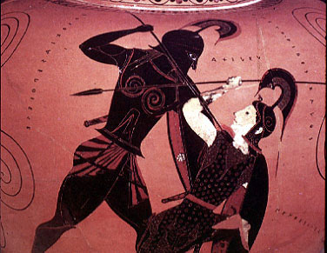
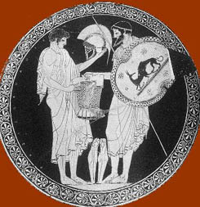
Greek heroes
Every culture and profession must have ideals and heroes
Physics: Newton, Einstein, Bohr, Feynman
Math: Euclid, Euler, Hilbert
Medicine: Hippocrates, Pasteur, Fleming

Slide 7
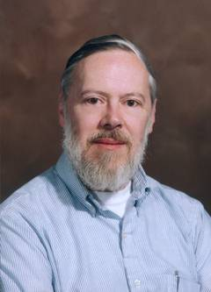
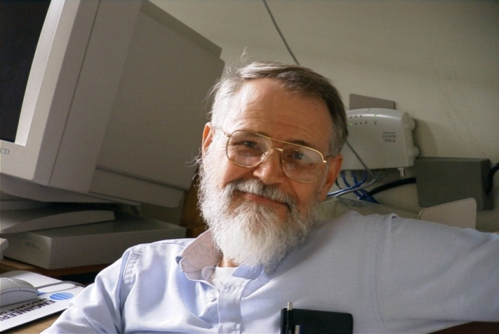
Geek heroes
Brian Kernighan
Programmer and writer extraordinaire
Dennis Ritchie
Designer and original implementer of C

Slide 8
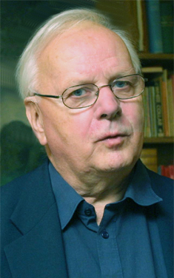
Another geek hero
Kristen Nygaard
Co-inventor (with Ole-Johan Dahl) of Simula67 and of object-oriented programming and object-oriented design

Slide 9
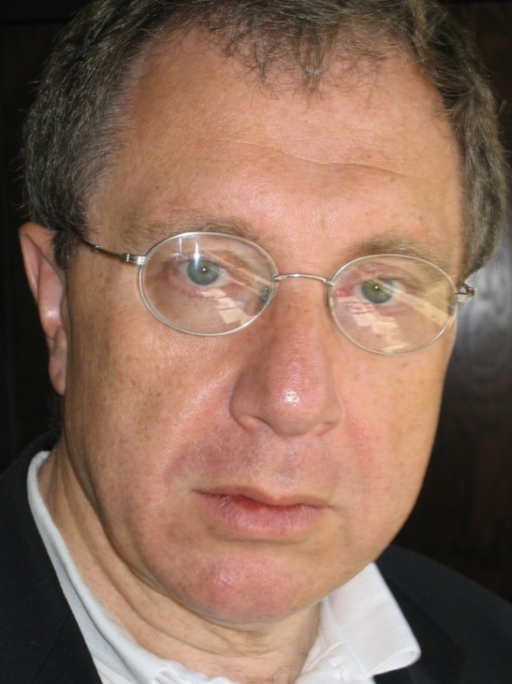
Yet another geek hero
Alex Stepanov
Inventor of the STL and generic programming pioneer

Slide 10
Two extremes
Academic beauty/perfection/purity
Commercial expediency
The pressures towards both are immense
Both extremes must be avoided for serious progress to occur
Both extremes encourage overstatement of results (hype) and understatement (or worse) of alternatives and ancestor languages

Slide 11
Ideals
The fundamental aims of good design
Represent ideas directly in code
Represent independent ideas independently in code
Represent relationships among ideas directly in code
Combine ideas expressed in code freely
where and only where combinations make sense
From these follow
Correctness
Maintainability
Performance
Apply these to the widest possible range of applications

Slide 12
Ideals have practical uses
During the start of a project, reviews them to get ideas
When you are stuck late at night, step back and see where your code has most departed from the ideals – this is where the bugs are most likely to lurk, and the design problems are most likely to occur
Don’t just keep looking in the same place and trying the same techniques to find the bug
“The bug is always where you are not looking – or you would have found it already”

Slide 13
Ideals are personal
Chose yours well

Slide 14

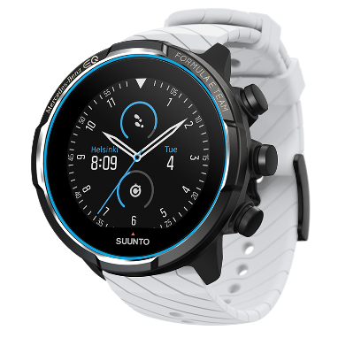
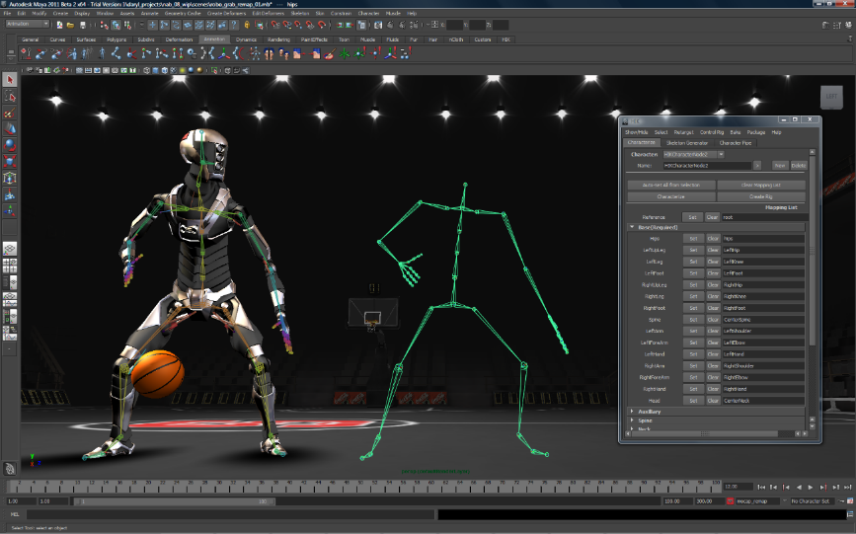








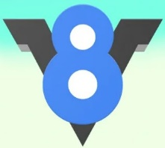






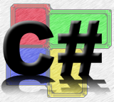
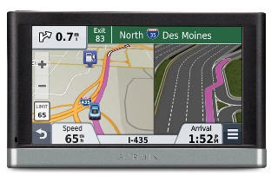

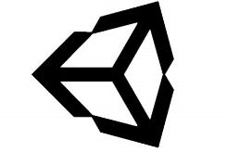


The value of a programming language
is in the quality of its applications
Notes:
This is what keeps me going; it’s what I think might inspire you; science! Engineering!

Slide 15
Styles/paradigms
Procedural programming
Data abstraction
Object-oriented programming
Generic programming
Functional programming, logic programming, rule-based programming, constraints-based programming, aspect-oriented programming, …

Slide 16
Styles/paradigms
template<Drawable_range C>
void draw_all(const C& c ) // a generic function (non-mutating)
{
for (const auto& x: c) // ordinary imperative programming
x->draw(); // the classical OOP example
}
Point p {100,100};
vector v // resource management
= { make_shared<Circle>(p,50), make_shared<Rectangle>(p, 250, 250) };
draw_all(v);
Which programming styles/paradigms did we use here?
Procedural, data abstractions, OOP, and GP!

Slide 17
Some fundamentals
Portability is good
Type safety is good
High performance is good
Anything that eases debugging is good
Access to system resources is good
Stability over decades is good
Ease of learning is good
Small is good
Whatever helps analysis is good
Having lots of facilities is good
You can’t have all at the same time: engineering tradeoffs

Slide 18
Programming languages
Machine code
Bits, octal, or at most decimal numbers
Assembler
Registers, load, store, integer add, floating point add, …
Each new machine had its own assembler
Higher level languages
First: Fortran and COBOL
Rate of language invention
At least 2000 a decade
Major languages today
Really solid statistics are hard to come by
IDS: about 9 million professional programmers
COBOL, Fortran, C, C++, Visual Basic, PERL, Java, Javascript
Ada, C#, PHP, …

Slide 19
Early programming languages
1950s:
1960s:
1970s:
Simula
Lisp
Algol60
Algol68
Fortran
Pascal
BCPL
Classic C
COBOL
PL/I
Yellow==will produce important “offspring”

Slide 20
Modern programming languages (~2010)
Lisp
Python
Smalltalk
PHP
Fortran77
Eiffel
Java95
Java04
Simula67
C89
C++
C++98
C++11
Ada
Ada98
C#
Pascal
Object Pascal
COBOL04
Javascript
COBOL89
Visual Basic
PERL

Slide 21
Why do we design and evolve languages?
There are many diverse applications areas
No one language can be the best for everything
Programmers have diverse backgrounds and skills
No one language can be best for everybody
Problems change
Over the years, computers are applied in new areas and to new problems
Computers change
Over the decades, hardware characteristics and tradeoffs change
Progress happens
Over the decades, we learn better ways to design and implement languages

Slide 22
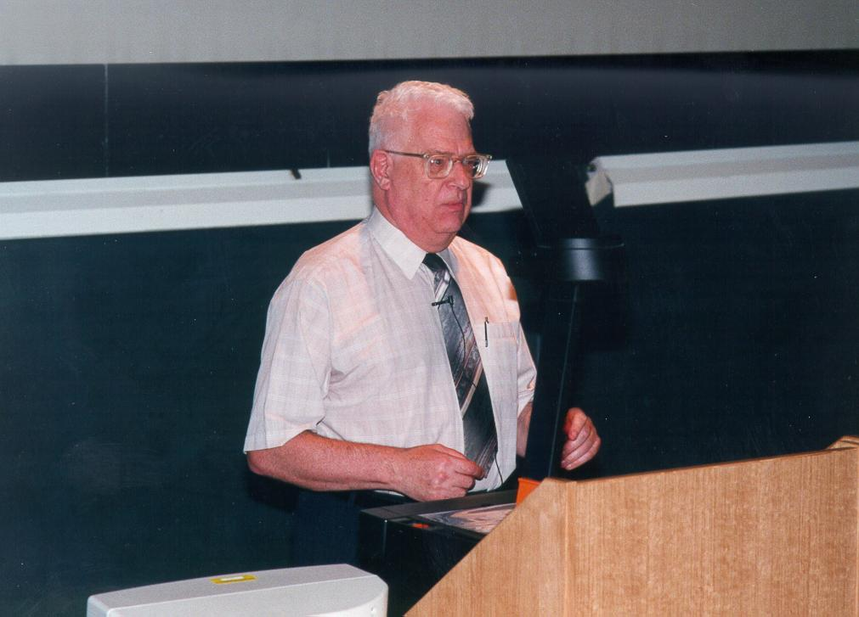
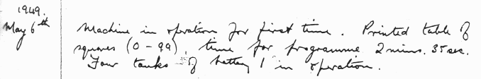
First modern computer – first compiler
David Wheeler (1927-2004)
University of Cambridge
Exceptional problem solver: hardware, software, algorithms, libraries
First computer science Ph.D. (1951)
First paper on how to write correct, reusable, and maintainable code (1951)
(Thesis advisor for Bjarne Stroustrup ☺)

Slide 23
Early languages – 1952
One language for each machine
Special features for processor
Special features for “operating system”
Most had very assembler-like facilities
It was easy to understand which instructions would be generated
No portability of code

Slide 24
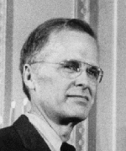
Fortran
John Backus (1924-2007)
IBM
FORTRAN, the first high level computer language to be developed.
We did not know what we wanted and how to do it. It just sort of grew.
The Backus-Naur Form (BNF), a standard notation to describe the syntax of a high level programming language.
A functional programming language called FP, which advocates a mathematical approach to programming.

Slide 25
Fortran – 1956
Allowed programmers to write linear algebra much as they found it in textbooks
Arrays and loops
Standard mathematical functions
libraries
Users’ own functions
The notation was largely machine independent
Fortran code could often be moved from computer to computer with only minor modification
This was a huge improvement
Arguably the largest single improvement in the history of programming languages
Continuous evolution: II, IV, 77, 90, 95, 03, 08, [15]

Slide 26
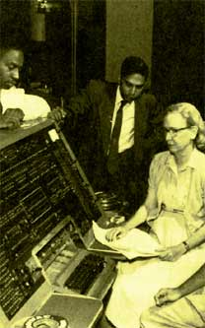
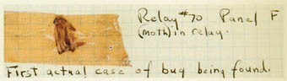
COBOL
“Rear Admiral Dr. Grace Murray Hopper (US Navy) was a remarkable woman who grandly rose to the challenges of programming the first computers. During her lifetime as a leader in the field of software development concepts, she contributed to the transition from primitive programming techniques to the use of sophisticated compilers. She believed that ‘we've always done it that way’ was not necessarily a good reason to continue to do so.”
(1906-1992)

Slide 27
Cobol – 1960
Cobol was (and sometimes still is) for business programmers what Fortran was (and sometimes still is) for scientific programmers
The emphasis was on data manipulation
Copying
Storing and retrieving (record keeping)
Printing (reports)
Calculation/computation was seen as a minor matter
It was hoped/claimed that Cobol was so close to business English that managers could program and programmers would soon become redundant
Continuous evolution: 60, 61, 65, 68, 74, 85, 02

Slide 28
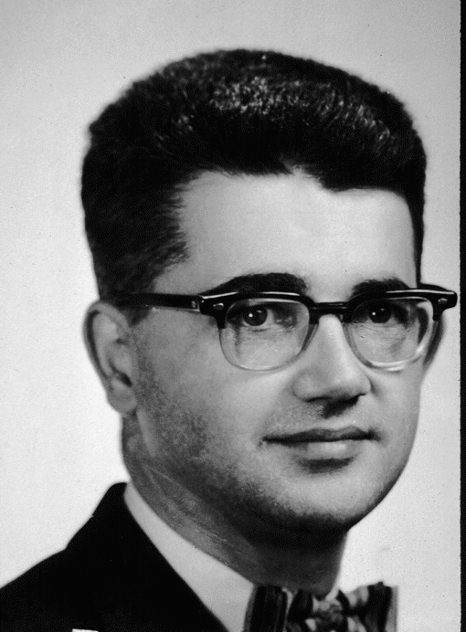
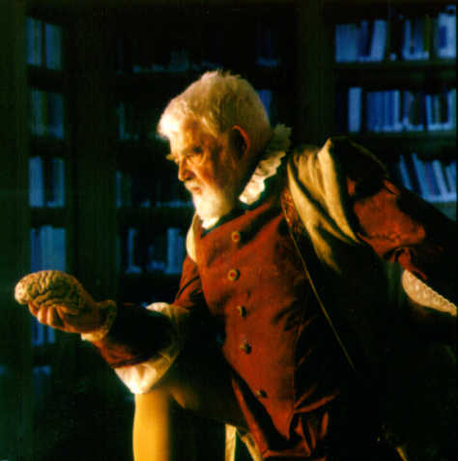
Lisp
John McCarthy (1927-2011)
Stanford University
AI pioneer

Slide 29
Lisp – 1960
List/symbolic processing
Initially (and often still) interpreted
Dozens (most likely hundreds) of dialects
“Lisp has an implied plural”
Common Lisp
Scheme
This family of languages has been (and is) the mainstay of artificial intelligence (AI) research
though delivered products have often been in C or C++

Slide 30
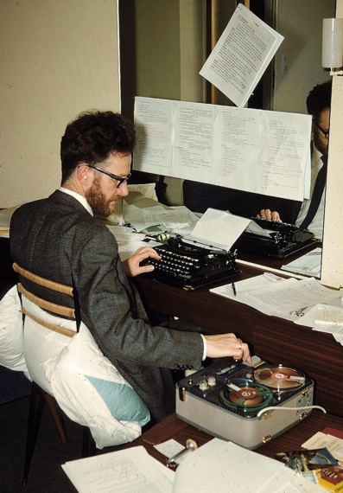
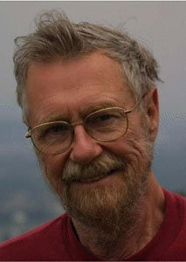
Algol
Peter Naur (b. 1928)
Danish Technical University and Regnecentralen
BNF
Edsger Dijkstra (1930-2002)
Mathematisch Centrum, Amsterdam, Eindhoven University of Technology, Burroughs Corporation , University of Texas (Austin)
Mathematical logic in programming, algorithms
THE operating system

Slide 31
Algol – 1960
The breakthrough of modern programming language concepts
Language description
BNF; separation of lexical, syntactic, and semantic concerns
Scope
Type
The notion of “general purpose programming language”
Before that languages were either scientific (e.g., Fortran), business (e.g., Cobol), string manipulation (e.g., Lisp), simulation, …
Never reached major non-academic use
Simula67
Algol58
Algol60
Algol68
Pascal

Slide 32
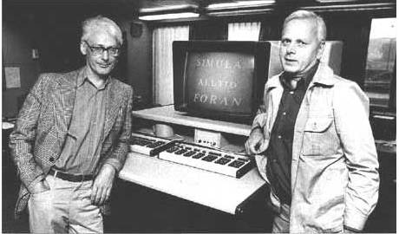
Simula 67
Kristen Nygaard (1926-2002) and Ole-Johan Dahl (1931-2002)
Norwegian Computing Center
Oslo University
The start of object-oriented programming and object-oriented design

Slide 33
Simula 1967
Address all applications domains rather then a specific domain
As Fortran, COBOL, etc. did
Aims to become a true general-purpose programming language
Model real-world phenomena in code
represent ideas as classes and class objects
represent hierarchical relations as class hierarchies
Classes, inheritance, virtual functions, object-oriented design
A program becomes a set of interacting objects rather than a monolith
Has major (positive) implications for error rates

Slide 34
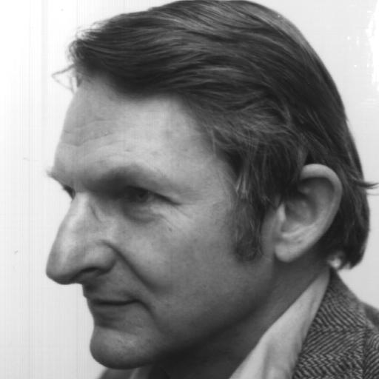
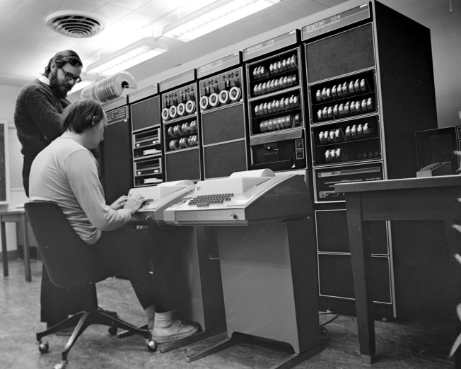
C
Dennis Ritchie (1941-2011)
Bell Labs
C and helped with Unix
Ken Thompson (b. 1943)
Bell Labs
Unix
Doug McIlroy (b. 1932)
Bell Labs
Everybody’s favorite critic, discussion partner, and ideas man (influenced C, C++, Unix, and much more)

Slide 35
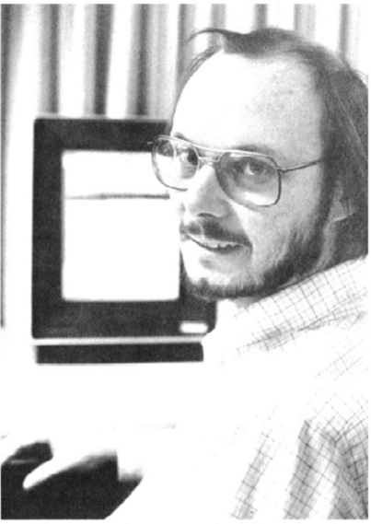

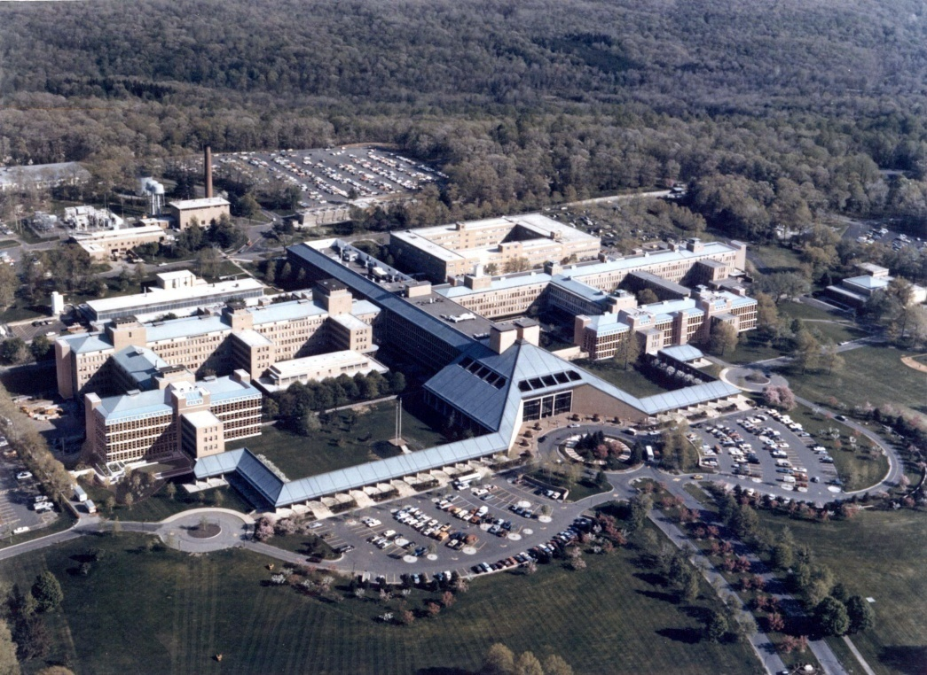

Bell Labs – Murray Hill
Notes:
A useful innovation comes from a challenging and supportive community

Slide 36
C – 1978
(Relatively) high-level programming language for systems programming
Very widely used, weakly checked, systems programming language
Associated with Unix and through that with Linux and the open source movement
Direct map to hardware
Performance becomes somewhat portable
Designed and implemented by Dennis Ritchie 1974-78
Bjarne Stroustrup, BTL, 1985
Dennis Ritchie, BTL, 1974
Ken Thompson, BTL, 1972
C++
C++98
C++11
CPL
BCPL
B
Classic C
C89
C99
C11
Martin Richards, Cambridge, 1967
Christopher Strachey, Cambridge, mid-1960s

Slide 37
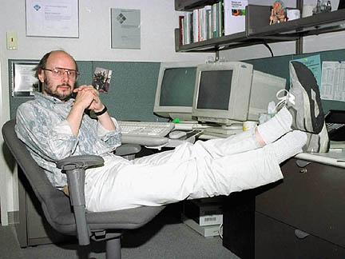
C++
Bjarne Stroustrup
AT&T Bell labs
Texas A&M University
Morgan Stanley (a bank)
Columbia University
making abstraction techniques affordable and manageable for mainstream projects
pioneered the use of object-oriented and generic programming techniques in application areas where efficiency is a premium

Slide 38
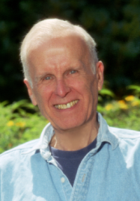
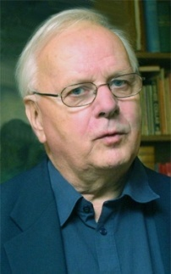
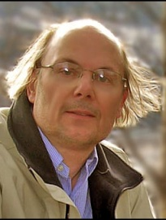
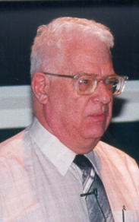
Programming Languages: C++ main ancestry
Domain-specific abstraction
General-purpose abstraction
Fortran
Cobol
Java
Simula
…
C#
C++
C++11
Direct mapping to hardware
C++23
C++20
Assembler
BCPL
C
C++14
C++17
Notes:
Backus

Slide 39
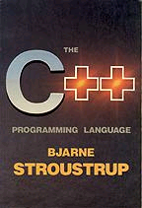
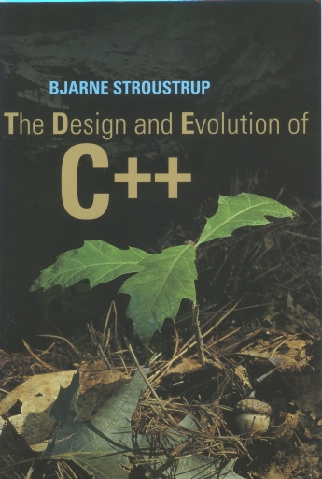
My ideals – in 1980 and more so in 2013 2024
“To make life easier for the serious programmer”
i.e., primarily me and my friends/colleagues
I love writing code
I like reading code
I hate debugging
Elegant and efficient code
I really dislike choosing between the two
Elegance, efficiency, and correctness are closely related in many application domains
Inelegance/verbosity is a major source of bugs and inefficiencies

Slide 40
C++ – 1985
C++ is a general-purpose programming language with a bias towards systems programming that
is a better C
supports data abstraction
supports object-oriented programming
supports generic programming
C++14
C++14
C++11
C++17
C++98
1978-89
1989
C++20
1979-84
ARM C++
Classic C
C with Classes
C++
C++23
Simula 67

Slide 41
More information
More language designer links/photos
http://www.angelfire.com/tx4/cus/people/
A few examples of languages:
http://dmoz.org/Computers/Programming/Languages/
Textbooks
Michael L. Scott, Programming Language Pragmatics, Morgan Kaufmann, 2000, ISBN 1-55860-442-1
Robert W. Sebesta, Concepts of programming languages, Addison-Wesley, 2003, ISBN 0-321-19362-8
History books
Jean Sammet, Programming Languages: History and Fundamentals, Prentice-Hall, 1969, ISBN 0-13-729988-5
Richard L. Wexelblat, History of Programming Languages, Academic Press, 1981, ISBN 0-12-745040-8
T. J. Bergin and R. G. Gibson, History of Programming Languages – II, Addison-Wesley, 1996, ISBN 0-201-89502-1
History of Programming Languages conference papers on C++
B. Stroustrup: Thriving in a crowded and changing world: C++ 2006-2020. ACM HOPL-IV. London. June 2020.
B. Stroustrup: Evolving a language in and for the real world: C++ 1991-2006. ACM HOPL-III. June 2007.
B. Stroustrup: A History of C++: 1979-1991. ACM HOPL-2. March 1993.

